Slide 1
Lab Automation System
Group Members: Talha (Leader), Faizan, Imad, Kamran , Mohsin

Slide 2
Project Overview
A web-based Lab Automation System for managing product tests in electrical appliances manufacturing.
Includes two main modules: Admin Panel and User Panel.
Streamlines product test data, report generation, and user management.

Slide 3
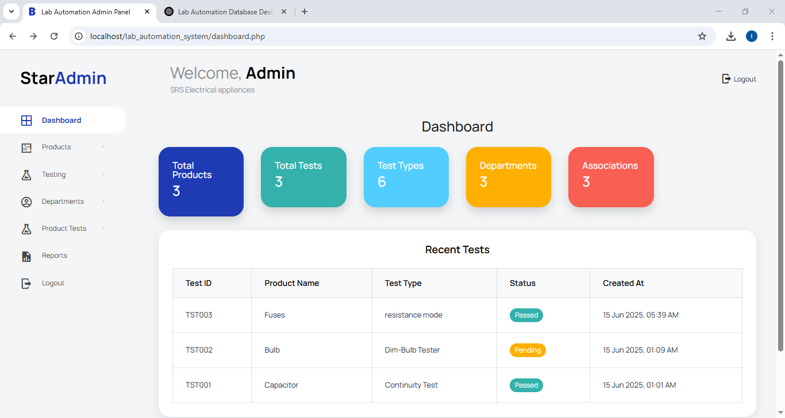

Slide 4
Admin Panel - Key Features
Secure login system for administrators.
Manage Products, Test Types, Departments, and Product Tests.
Generate and export test reports in CSV format.
Responsive dashboard using Star Admin 2 template.

Slide 5
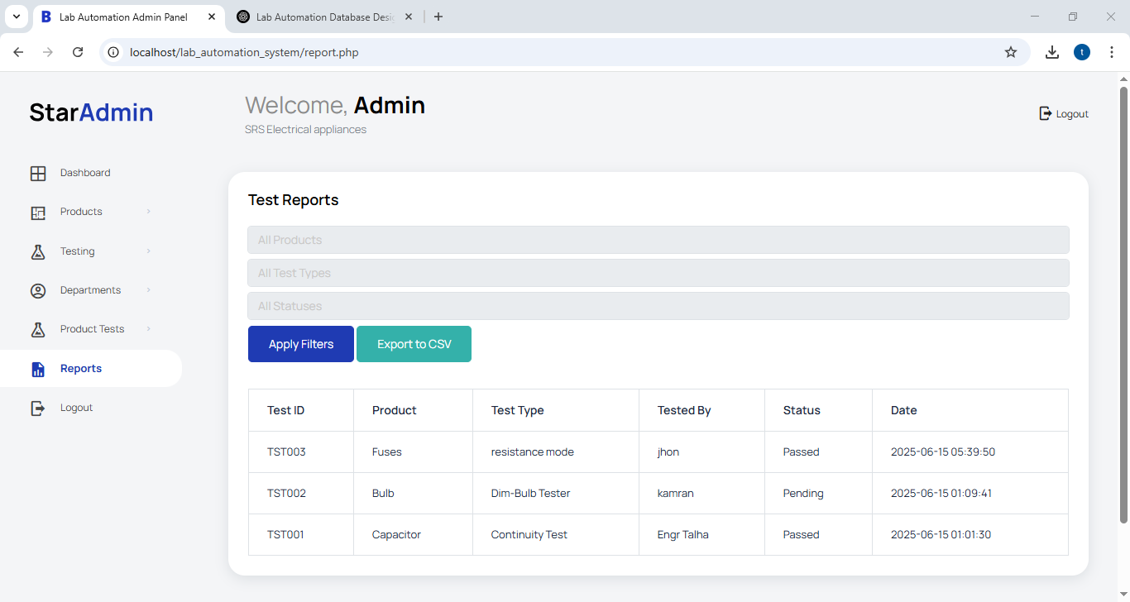

Slide 6
Admin Panel - Functionality
Add/Edit/Delete Products and related test records.
Assign tests to departments and testers.
Filter and search reports with multiple criteria.

Slide 7
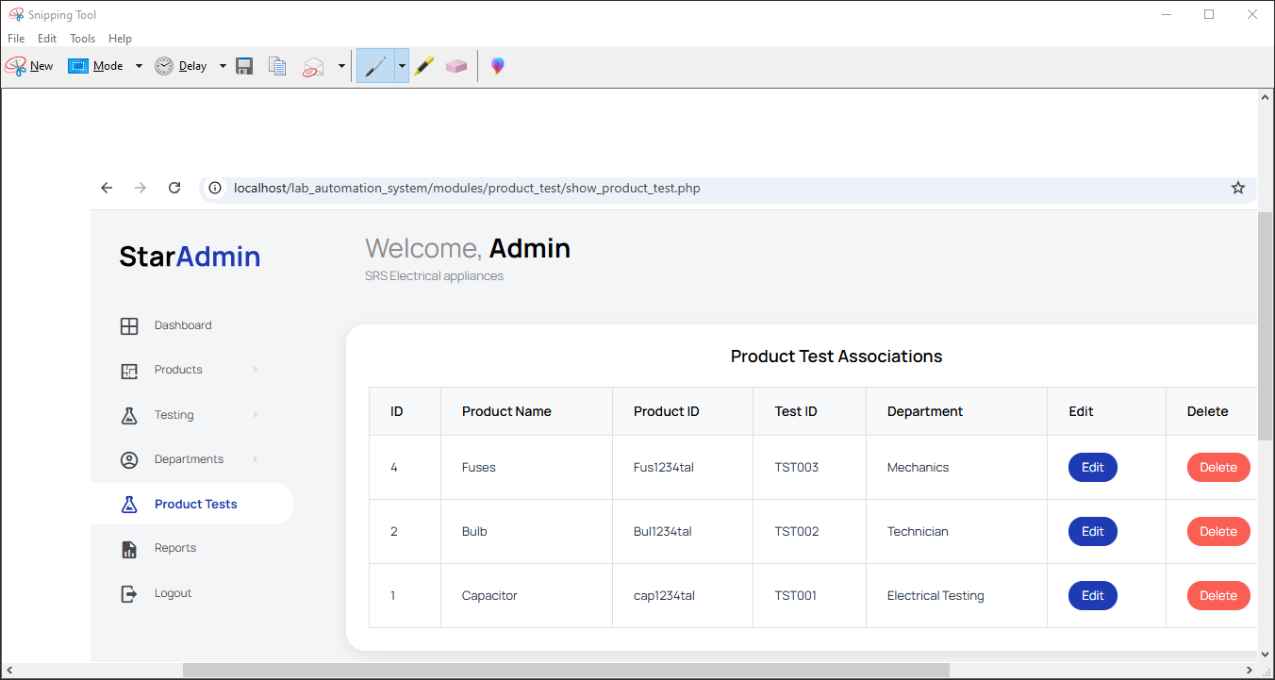

Slide 8
User Panel - Overview
Frontend interface for companies in the electrical appliance field.
Allows company to view their tests
Companies can also view there products

Slide 9
User Panel - Website Pages
Home - Overview and welcome message.
About Us - Details about the Lab Automation system.
Products - Description of Products offered.
Our Tests - Displays Tests types involved in the system.
Contact Us - Company address and inquiry form.
Feedback - Collect user feedback and testimonials.

Slide 10
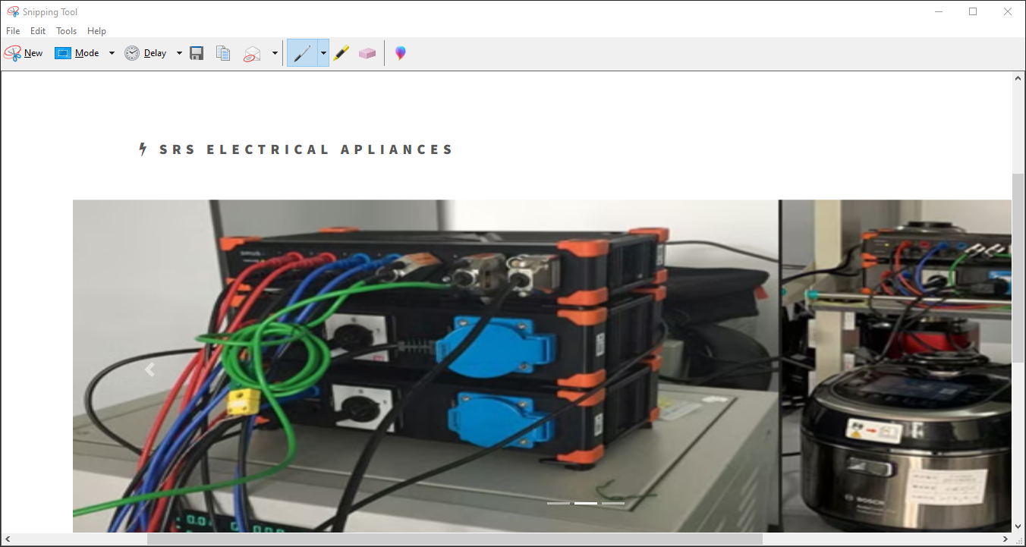

Slide 11
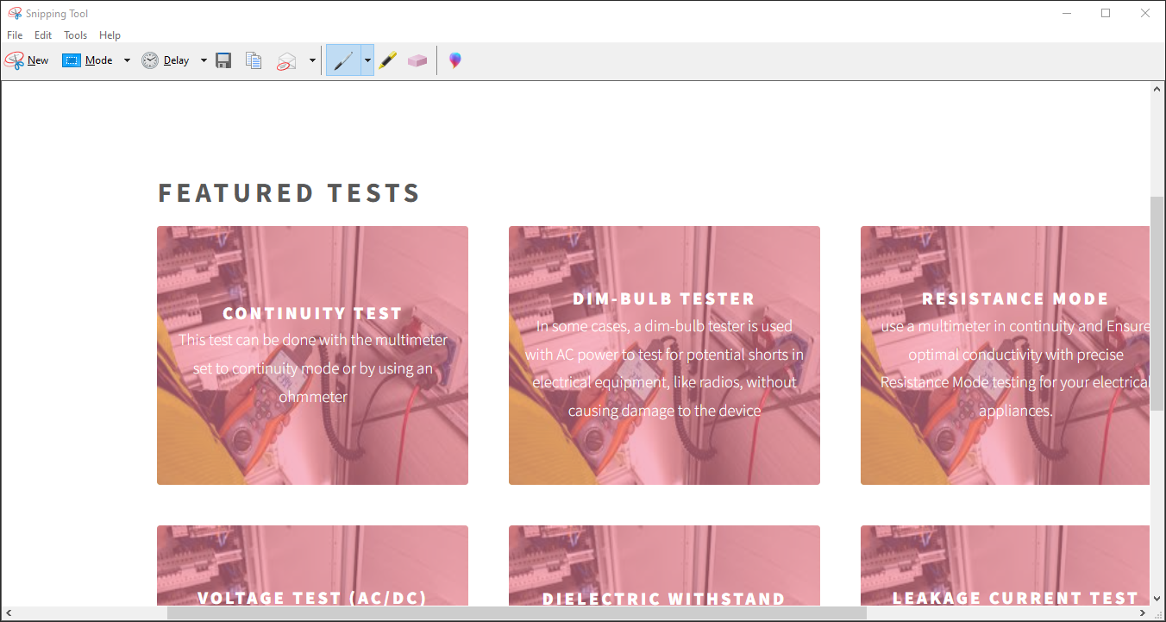

Slide 12
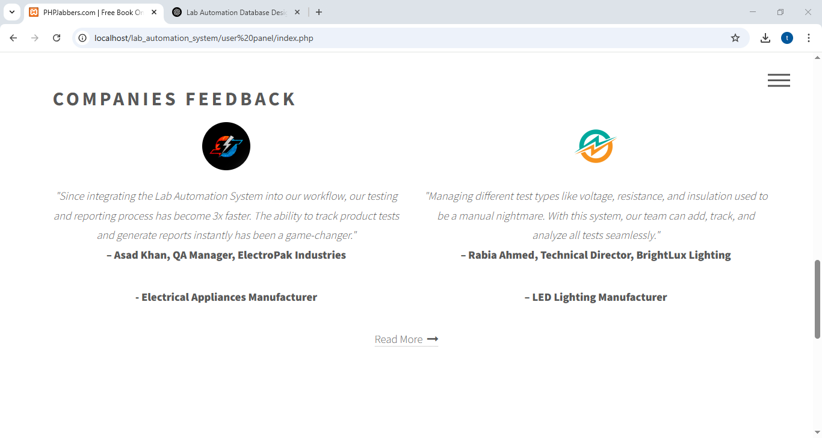

Slide 13
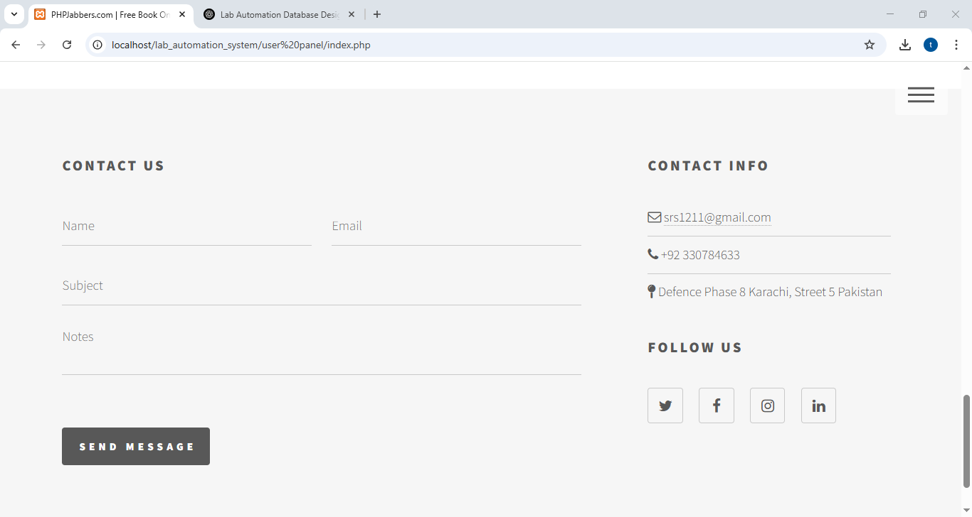

Slide 14
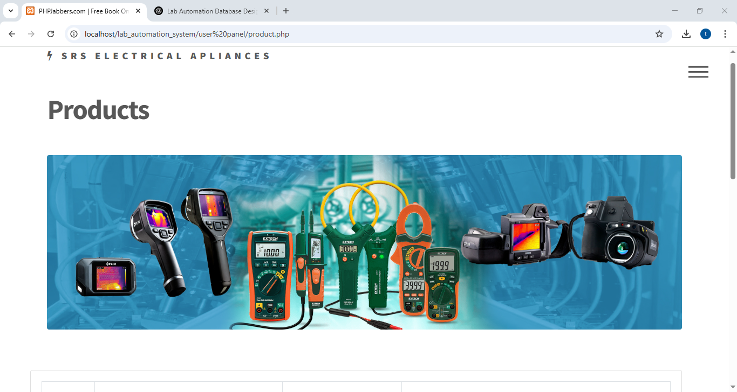

Slide 15
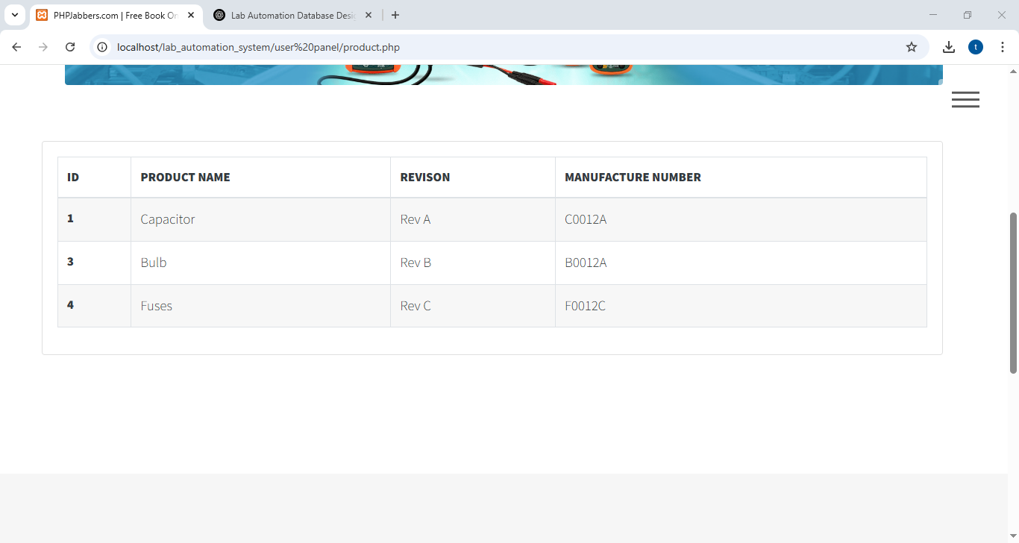

Slide 16
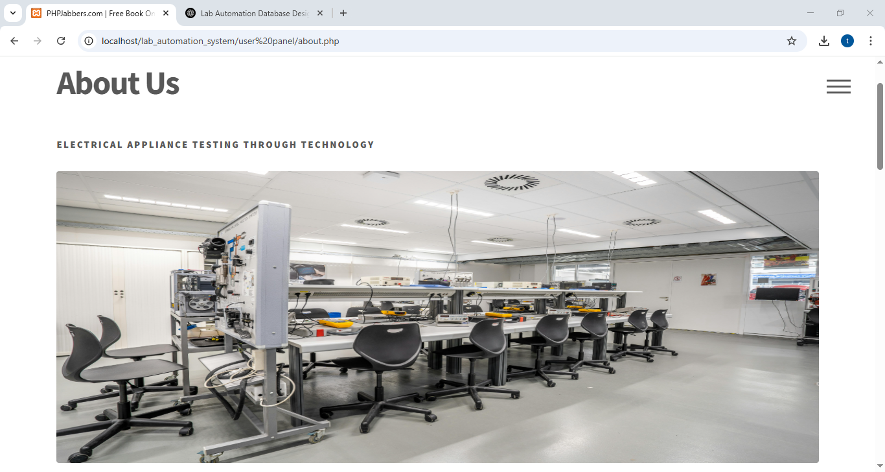

Slide 17
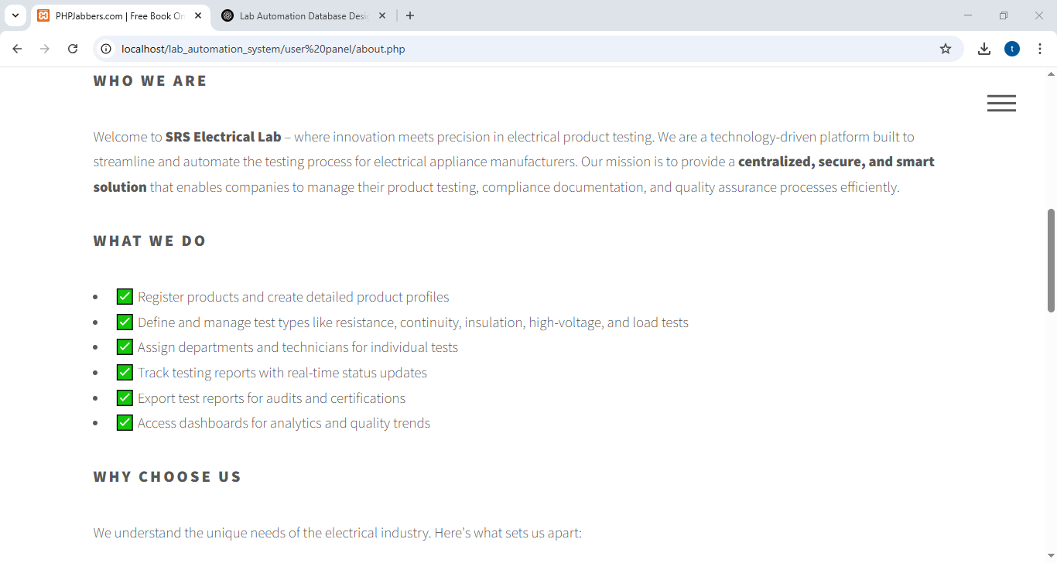

Slide 18
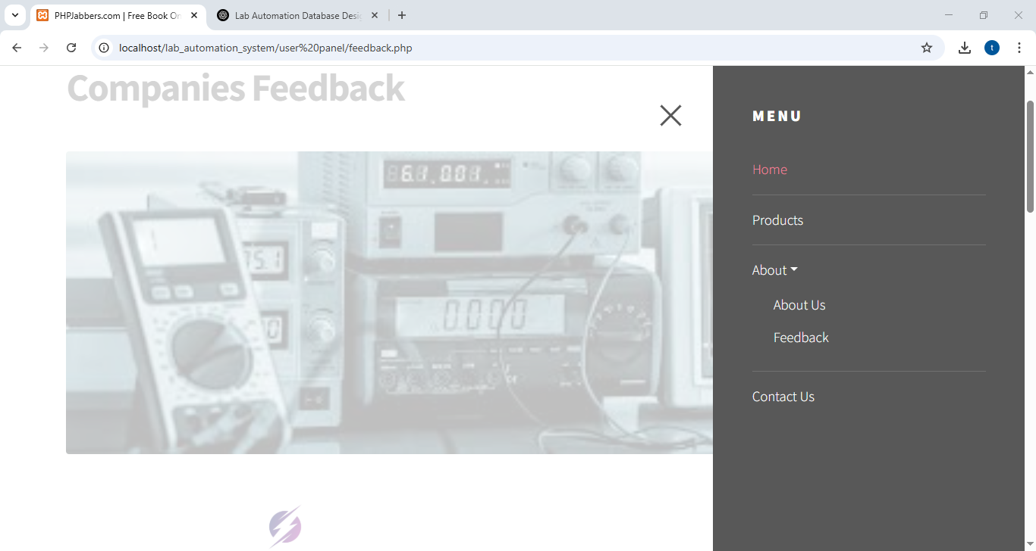

Slide 19
Technologies Used
Frontend: HTML, CSS, Bootstrap 5
Backend: PHP, MySQL
Admin Template: Star Admin 2
Hosting: XAMPP (Localhost)

Slide 20
Challenges and Solutions
Integrating report export to CSV – Solved using native PHP headers.
Sidebar collapsing – Resolved layout issues with container-fluid.
Session management and secure login/logout – Fixed using PHP sessions.

Slide 21
Future Enhancements
User-specific dashboards with role-based access.
Integrate email notifications for reports.
Deploy system on a live server (AWS, cPanel).

Slide 22
Conclusion
Successfully developed a complete lab management solution.
Efficient handling of product test records and reporting.
Improves productivity and reduces manual errors in lab testing.

